Slide 1

Welcome to
Scotland’s Census 2022
Census Roadshows
June 2021

Slide 2
General Update

Slide 3
Scotland Census 2022 Programme – High level timeline
2016 2017 2018 2019 2020/21 2022 2023
Design
Procure, Build, Test
Rehearsal
Operational
Readiness
Census &
Processing
Dissemination
Establish the programme
Develop overall design
Engage with suppliers
Refine questions
Contract with suppliers
Plan for Rehearsal
Conduct rehearsal
Test integration of all aspects
Scale up for census
Legislative Approval
Collect census data
Census coverage survey
Process data
Disseminate results
Support use of census information

Slide 4
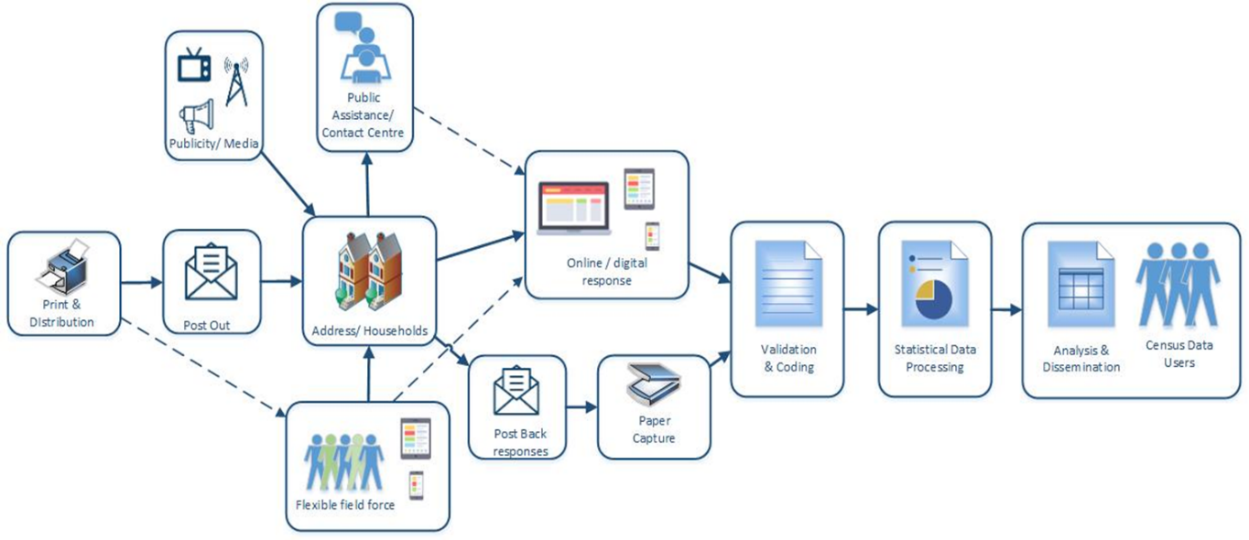
High Level Design

Slide 5
SDC and Outputs
Enumeration Strategy

Slide 6
Introduction to Enumeration
What is enumeration?
Enumeration is the process of collecting data from the people of Scotland during the census.
This includes the operation aspects of census data collection, such as:
Direct contact
Encouragement of self-response (including digital self-response), and
Follow up
Enumeration Strategy
Our enumeration strategy and
approach has been informed by a
number of key inputs, and we have
continued to iterate and refine this
approach over time.
2011 Census
Digital First
Royal Mail delivery
2017 Research
Non-response follow-up
2019 Rehearsal
Reminder letters
Communal Establishments
Contact materials
Contact materials
2020 Content Audit Review
Contact materials
International Best Practice
Stakeholder Engagement

Slide 7
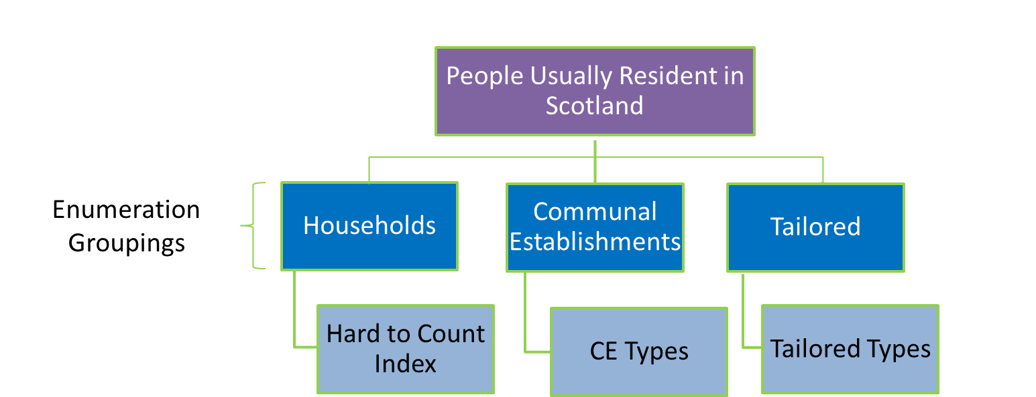
Introduction to Enumeration
Why do we enumerate?
Scotland’s Census will collect information of everyone usually resident within Scotland on census data.
Information on visitors will be collected similar to 2011.
Enumeration Groupings
To ensure the proposed approaches are fit
for purpose, Scotland’s population will be
split into three main groups of respondents
Standard households
Communal establishments
Population groups which require
a tailored approach

Slide 8
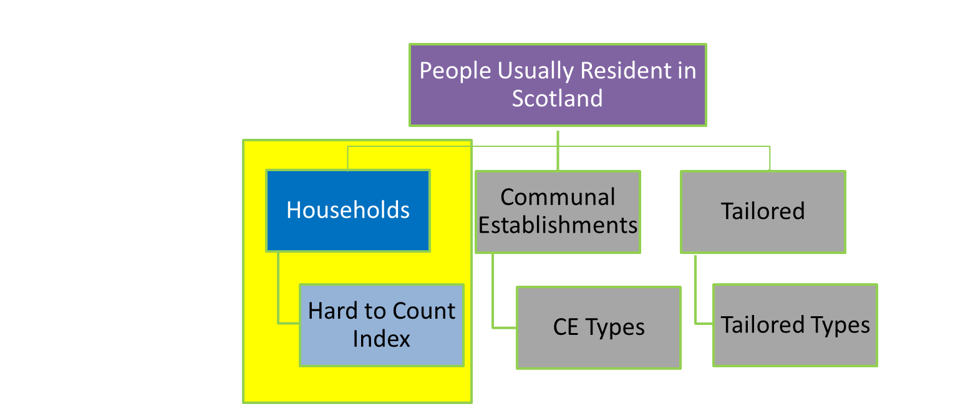
Household Enumeration
Standard Households
A household is defined as:
A person living alone, or
A group of people (not necessarily related) living at the same address who share cooking facilities and share a living room or sitting room or dining area
There was a total of 2,473,881 households in 2011.
Hard to Count (HTC) Index
This index predicts how difficult it will be to count
households in an area based upon demographic
factors associated with low levels of response to
the 2011 census, and other, more recent surveys.

Slide 9
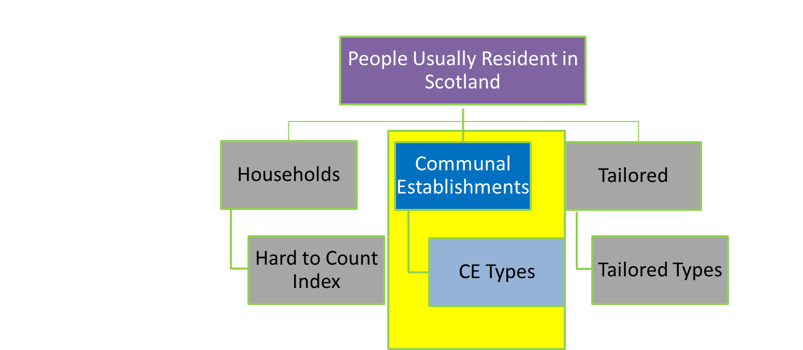
Communal Establishments (CEs)
Communal Establishments
A communal establishment (CE) is defined as:
A typically managed residential accommodation where there is full time or part time supervision of the accommodation
Communal Establishment Groupings
We have 4 communal establishment groupings
that allow us to consider the strategies and
tactics that will be requires to maximise
response with these different segments.
2011 - Number of Communal Establishments (CEs) | 5,425
2011 - No. residents in CEs | 99,017

Slide 10
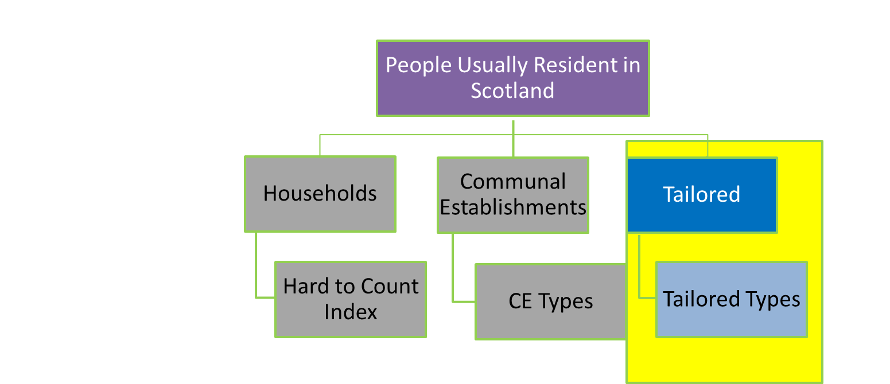
Tailored Enumeration
Tailored enumeration is defined as:
a bespoke approach to maximise census returns from identified population groups, with specific characteristics or corresponding lifestyles which do not allow enumeration to take place using standard design models (household or communal establishment).
Difficult to get number of some of these groups
as they were just included in the household
Figures from 2011.
Major challenge is identifying these addresses
in the first place.

Slide 11
Enumeration approach
We have defined Enumeration Approaches for each of the groupings and segments.
Letter
Census Day
Reminders
Non-response follow-up
Postcard
Households
Postcard
Census Day
Follow-up
Courier Delivery
Courier Collection
CEs
Public Assistance
Self Service
Assisted Service
Mediated Service
Communication and Engagement

Slide 12
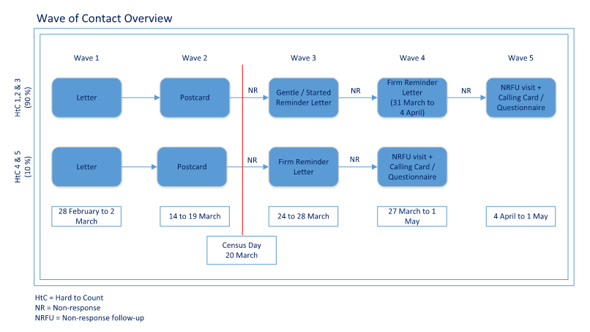
Wave of Contact Model – Overview
Notes:
Our wave of contact model signifies how and when we will initiate contact with Households

Slide 13
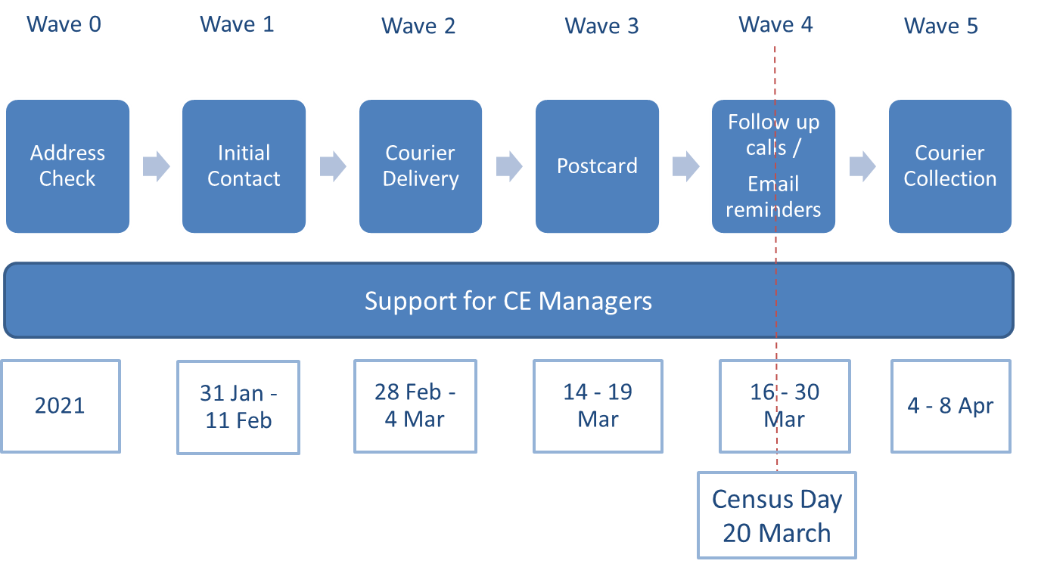
Wave of Contact Model – Communal Establishments
10 Mar
Enumeration Day
16 March
22 - 23 Mar
Rough Sleepers

Slide 14
Question and Questionnaire Design
Topic Consulation 2015/2016
Stakeholder Engagement
Involvement of Users
Public acceptability, cognitive and qualitative testing
Topic focus groups
Usability and accessibility testing
Rehearsal
Legal and Ministerial
National Statistics Accreditation

Slide 15
Legislation
Published ‘Plans for Scotland’s Census 2021’ in September 2018
Census Amendment Scotland Act 2019 – allows for voluntary questions to be asked on sexual orientation and trans status and history. Received Royal Assent in July 2019.
All of the legislation required for Scotland’s Census 2022 is now in force
Scotland’s Census 2022 Question Set

Slide 16
Census Coverage Survey (CCS)
To provide a secondary source of data to the census which allows us to estimate the total Scottish population
Not everyone completes a Census questionnaire and some people are missed
Does not occur uniformly across all geographic areas or demography
Individuals or whole households can be missed

Slide 17
The CCS is…
Sample survey
Includes approximately 1.5% of the population
Conducted approximately 6 weeks after census
Subset of the census questionnaire
Door-step interview, face-to-face
Voluntary participation

Slide 18
Statistical Methodology

Slide 19
Statistical Quality AssuranceSta
(Paper) Capture
To convert responses into electronic data.
Coding
The process by which responses given by an individual or household are turned in to a recognised and consistent numerical code.
Data Cleansing
A collection of processes we apply to Census data to account for specific errors, and prepare the data so it’s suitable for later statistical processes.
Administrative Data
We use other data sources that are independent of census to check the data we receive in census is what we expect.
Edit and Imputation
ensures the data are complete and consistent at record level.
Census Coverage Survey (CCS)
A secondary survey that happens after census day to provide a secondary source of data to the census which allows us to estimate the total Scottish population.
Estimation and Adjustment
Estimation produces overall population and household estimates, Adjustment creates new records for the missed population and both combined gives a Census dataset for whole population.
We use other data sources that are independent of the census and expert panels to ensure our population estimates are correct, accurate and what we would expect.
Statistical Disclosure Control
To prevent the release of disclosive or confidential information about an individual or household.
Outputs
Validation of Population Estimates
Statistical Methodology website main page
High level overview published on our website
Papers reviewed by NRS Internal Peer Review
Papers reviewed by External Methodology Assurance Panel
Papers and panel reports published on our website
PAMS are invited to comment on any aspect of the methodology or the assurance process either at the meeting, or by email to scotlandscensus@nrscotland.gov.uk
To produce the statistical outputs, supporting information and analysis for release to the public.

Slide 20
Communications and Engagement

Slide 21
Stakeholder and Community Engagement
Low earners/ people with chaotic lifestyles / parents of young children
Vulnerable Black/Ethnic Minorities and Roma
How you can help with our engagement
Help us identify umbrella organisations and trusted intermediaries
Help us identify key communities in your local area
Help us identify conferences and events across Scotland
Veterans
Students
Older people
LGBT
Gaelic speakers
People with disabilities/ literacy problems/ mental health issues
Young adults
Refugee/
Asylum seekers /recent migrants
Carers

Slide 22

Case Studies are Key
Can you provide case studies relating to:
Mental health
Island Communities
Economy focused
Queensferry Crossing
When planning was underway for the new £1.35bn Queensferry Crossing, census data was used to help make decisions on its need, location and size.
Stephen Cragg from Transport Scotland said: “This decision was informed, in part, by census data and based on how much disruption the repairs would cause to travellers and the economy."

Slide 23
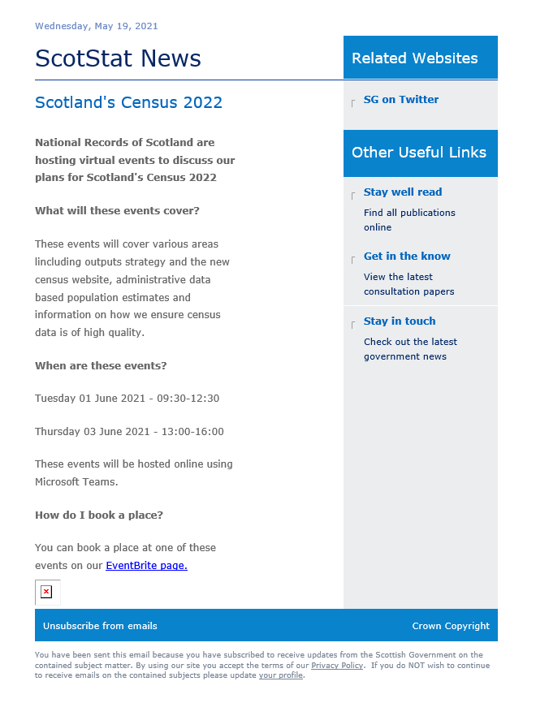
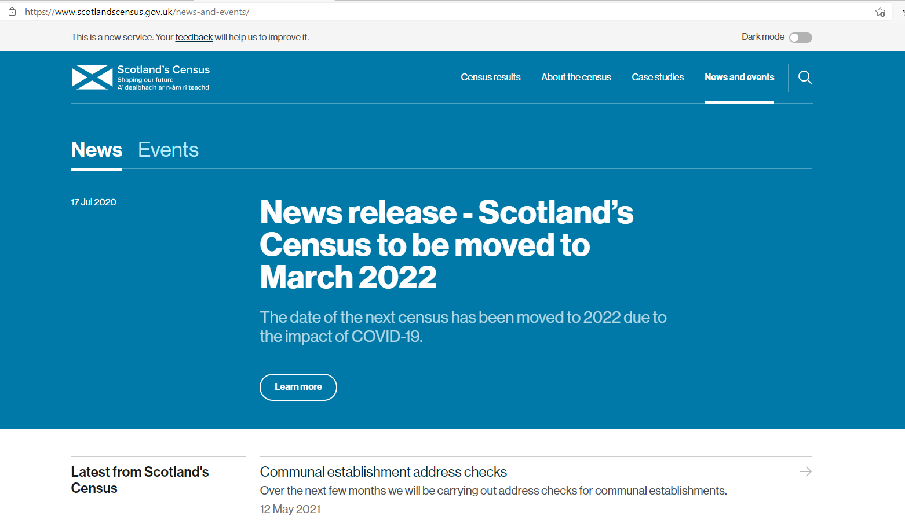
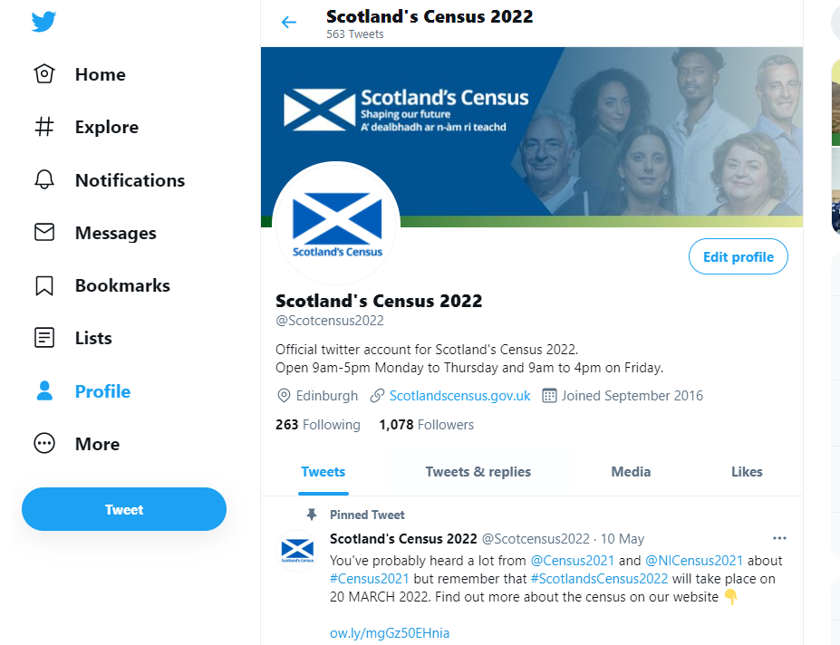
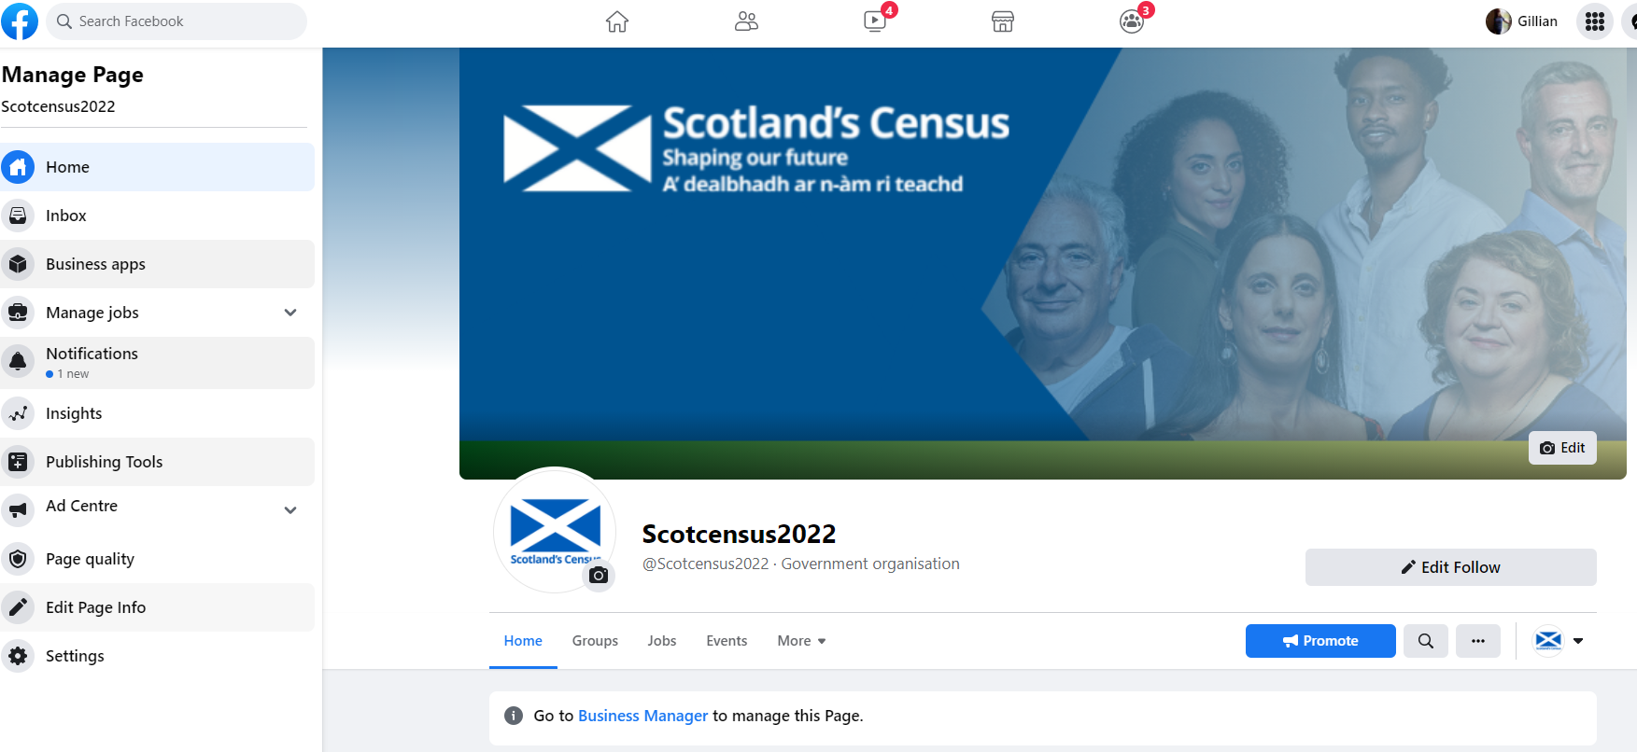
Communications Channels
Scotlandscensus@nrscotland.gov.uk

Slide 24
Administrative Based Population Estimates
(ABPE)

Slide 25
SDC and Outputs
Background

Slide 26
Publication – Statistical Research
Published on NRS website on 17th November 2020
Main Report:
Administrative Data based Population Estimates, Scotland 2016
Methodology Report
Interactive Charts – Local Authority
Additional Resources
Data Protection Impact Assessment (DPIA)
Quality Assurance of Administrative Data (QAAD)
Voluntary Adoption of Code of Practise for Official Statistics

Slide 27
Aim
Produce a population estimate using administrative data from public sector
This work will eventually feed in to recommendations for the future of the census and demographic statistics in Scotland

Slide 28
Datasets Used
National Health Service Central Register – NHSCR (NRS)
Health Activity (PHS)
Register of Electors (EROs)
Scottish Pupil Census (SG)
Vital Events (NRS)
Further Education Statistics (SFC)
Higher Education Statistics Agency (HESA)
Residential Sales (RoS)

Slide 29
SDC and Outputs
Methodology

Slide 30
Separation of Functions

Slide 31
De-Identification
For example, Lindsay Bennison is now represented by the following one-way process:
Forename = c175447679ae2047fa
Surname = 2fb538526102fec9w

Slide 32
Data Flowchart

Slide 33
Business Rules: Exclusions
Death registration on or before 30/6/2016
On NHSCR as
Outwith UK
Outwith Scotland
Died
On electoral register as overseas voter

Slide 34
Business Rules: Inclusions
Either:
On NHSCR with a Scottish posting, and
On at least one other dataset
Or: appear on birth registrations with a birth in the past year

Slide 35
SIDD to ABPE
The business rules are applied to all the de-identified persons in the dataset
The trimmed down dataset is known as Scotland’s Integrated Demographic Dataset (SIDD)
The counts of people from this dataset are the Administrative Data Based Population Estimates (ABPE)

Slide 36
SDC and Outputs
Results

Slide 37
Overall Comparison

Slide 38
Differences by Age and Sex

Slide 39
Differences by Urban-Rural

Slide 40
Differences by SIMD

Slide 41
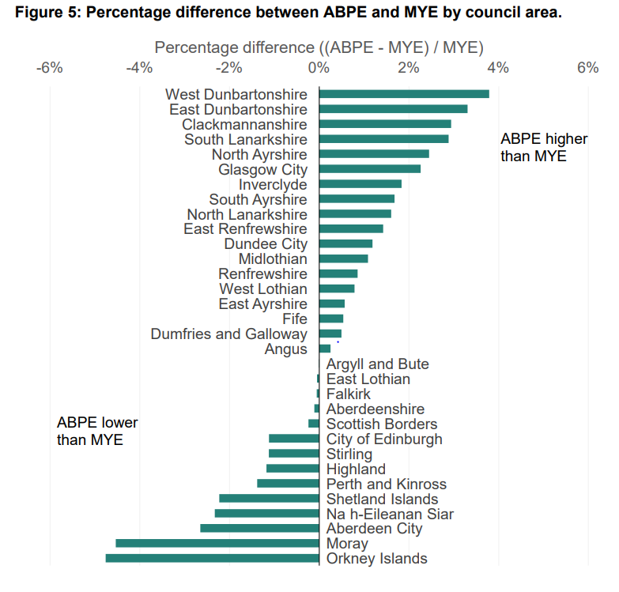
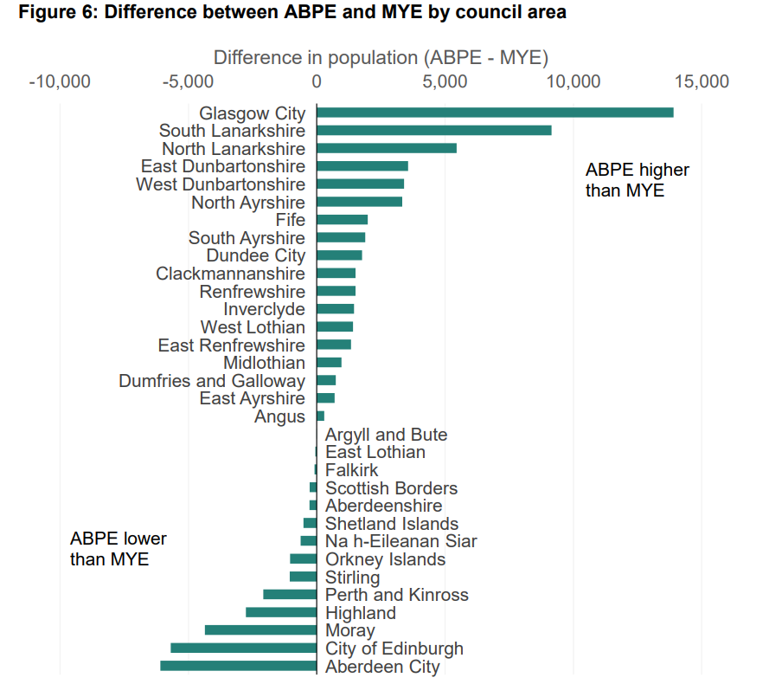
Council Area Difference

Slide 42
SDC and Outputs
Next Steps

Slide 43
Future Developments
This is the first set of research results
Next publication will cover 2017 and 2018 – test whether the trends are similar to those in 2016 – investigate the causes of any changes
Working with demographic team to get a better understanding of the council areas – looking at lower geographies
Business rules may change with a better understanding of the data
Explore using estimation (e.g. Dual-System Estimation) instead of counts
  Multiple admin data lists, or
  Survey data as a population coverage survey
More administrative datasets – scoping to see if we can improve certain age ranges

Slide 44
Quality Assurance of Census Data

Slide 45
Statistical Quality Assurance
Assurance of Processes – aim to make sure we do not add bias or error to the census data.
Validation of population estimates - aim to ensure our population estimates are correct, accurate and what we would expect.
Census Quality Survey – after careful consideration we have opted not to conduct a CQS. We have an extensive and in-depth alternative programme of statistical quality assurance that significantly improves on our approach in 2011.
National Statistics Accreditation – engaging with OSR to ensure the census data are high quality, trustworthy and of value.

Slide 46
Statistical Quality Assurance Strategy
We’ve recently published an updated version of our strategy for statistical quality assurance of the census. Views welcome – final version to be published early next year.
Sets out how we will how we will assess and measure the level of quality being achieved throughout the collection and processing of Census data and the production and dissemination of statistical outputs.
https://www.scotlandscensus.gov.uk/documents/pmp006-statistical-quality-assurance-strategy/

Slide 47
Assurance of Processes
We are building secondary QA checks at every step of the Census data journey to check that we are not introducing errors or bias to the data.
This is vital for ensuring appropriate methodologies, including the development of meaningful quality indicators, are in place and being followed.
Running in parallel with census data processing – checks to be done immediately after each process is completed.

Slide 48
Statistical Quality AssuranceSta
(Paper) Capture
To convert responses into electronic data.
Coding
The process by which responses given by an individual or household are turned in to a recognised and consistent numerical code.
Data Cleansing
A collection of processes we apply to Census data to account for specific errors, and prepare the data so it’s suitable for later statistical processes.
Administrative Data
We use other data sources that are independent of census to check the data we receive in census is what we expect.
Edit and Imputation
ensures the data are complete and consistent at record level.
Census Coverage Survey (CCS)
A secondary survey that happens after census day to provide a secondary source of data to the census which allows us to estimate the total Scottish population.
Estimation and Adjustment
Estimation produces overall population and household estimates, Adjustment creates new records for the missed population and both combined gives a Census dataset for whole population.
We use other data sources that are independent of the census and expert panels to ensure our population estimates are correct, accurate and what we would expect.
Statistical Disclosure Control
To prevent the release of disclosive or confidential information about an individual or household.
Outputs
Validation of Population Estimates
Statistical Quality Assurance
to prevent, reduce or limit the occurrence of errors and therefore, to get it right first time.
At each step in data journey, perform a secondary level of QA to ensure process has worked correctly.
Using dashboards to analyse the data, using thresholds to highlight potential issues.
To produce the statistical outputs, supporting information and analysis for release to the public.

Slide 49

Validation of Population Estimates
After Estimation and Adjustment steps in data processing, we will use independent data sources to check that our National and Local Authority population estimates are accurate.
Quality Assurance Panels with local authorities for QA in secure setting prior to first outputs.
All before first outputs in March 2023.

Slide 50
Validation of Population Estimates
Topic-based analysis - comparing our topic-based population estimates to other data.
We will use independent data sources to check that our topic based population distributions are accurate.
Quality Assurance of Administrative Data (QAADs) documents will be produced for each data source.

Slide 51
Validation of Population Estimates
We will use aggregate level data sources for some topic areas - e.g. Census Household Topic Questions will be compared with the Scottish Household Survey and the Scottish House Condition Survey where possible.
While for other areas, individual-level data sources will be used to validate the census results

Slide 52
Validation of Population Estimates
Use of individual data to quality assure the census is new to 2022.
The data is only being used to quality assurance NOT augment the census.
Governance and security procedures needed were sought and approved.
Methodologies using admin data were piloted in the statistical rehearsal 2020. All findings were submitted to EMAPs for review and publication.
These new methodologies were more successful at identifying duplicate entries, retaining genuine records and improving imputation for missing dates of birth.

Slide 53
Census Quality Survey (CQS)
Historically the Census Quality Survey (CQS) was a voluntary survey carried out across Scotland eight weeks after the census day. It aimed to capture the differences between responses in Census compared to the CQS.
However, for Scotland’s Census 2022 we have changed our approach and we will not carry out a CQS in the traditional way. Instead we will use alternative data quality measures which offer robust and extensive assurance that Scotland’s Census 2022 produces high quality data and is of value to the people of Scotland.
We have developed additional quality assurance processes that significantly improve our approach to ensure Census data is high quality. The new approach we have adopted relies on the robustness, quality and value of existing statistical quality assurance processes.

Slide 54
National Statistics Accreditation
We have a responsibility to ensure the results of the 2022 Census in Scotland are correct, accurate and adhere to the Code of Practice for Statistics as determined by the UK Statistics Authority.
Published How the National Records of Scotland is ensuring Census 2021 is trustworthy, high quality and of value to users report in June 2019. Working on addressing actionable findings identified by OSR – will publish phase 2 report in early 2022.
The OSR will also consider evidence from a variety of sources including its own research, information we at NRS have given them and, importantly, feedback from users and stakeholders connected with the census. Capturing the views of users and potential users forms an important part of OSR’s judgement about the statistics, including how they could be improved. If you would like to comment or speak to OSR, please see detail of the assessment on its website.

Slide 55
Statistical Disclosure Control (SDC) and Outputs

Slide 56
SDC & Outputs Update
The new Census website
Flexible Table Builder beta
Outputs release planning
Harmonisation update

Slide 57
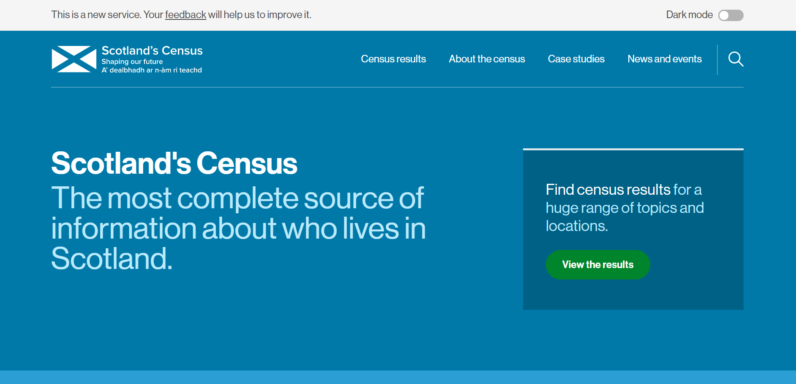
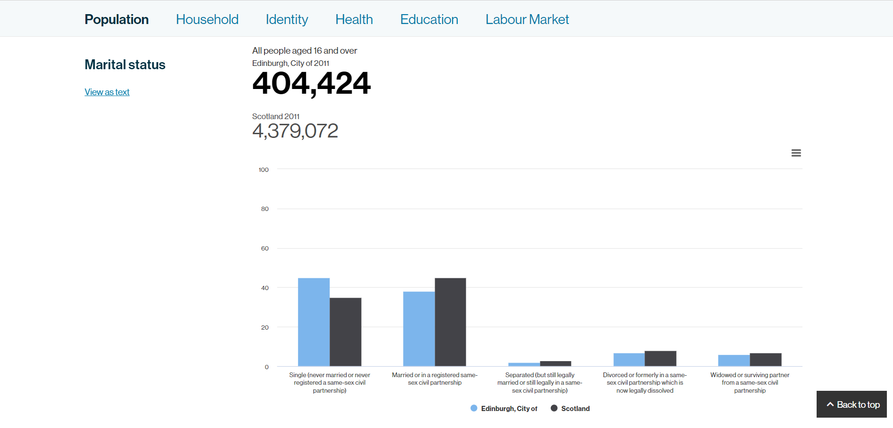
Census Website
Following some user research we decided to develop an new website for Scotland’s Census 2022 outputs.
Research showed that the old website could be difficult to navigate and that the range of data available was not meeting users needs.
By developing a new website we hope to improve the experience for users and attract new users of Census data
The new website was launched May 2021.

Slide 58
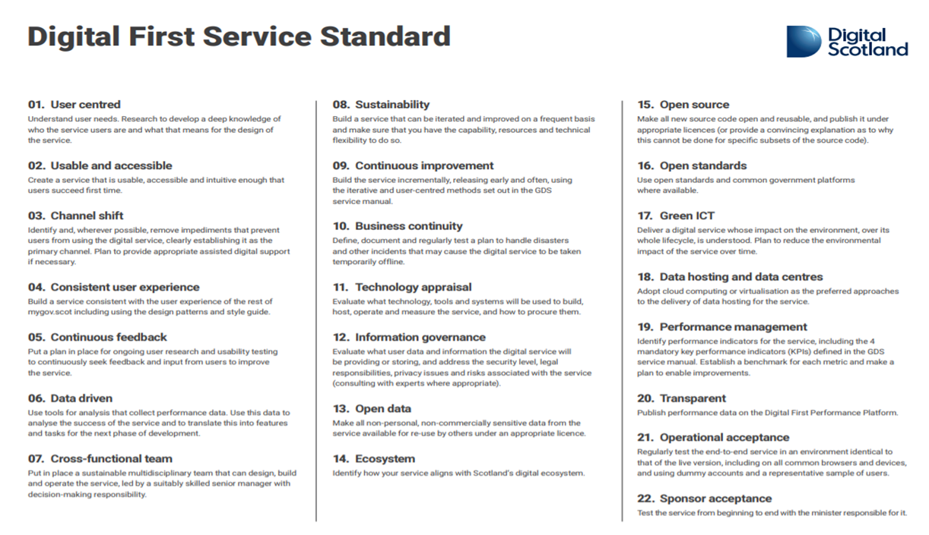
Website – Digital First
The Digital First Service Standard is a set of 22 criteria that all digital services developed by Scottish Central Government sector organisations and Scottish Government corporate services must meet.
The standard has 3 themes:
user needs
technology - how you’ve built your service
business capability and capacity
The standard aims to make sure that services in Scotland are continually improving and that users are always the focus.

Slide 59
Website – User Research
Throughout the project, we have engaged with
167 participants in research and testing sessions
355 completed treetests
66 completed card sort
Research and testing methods used
User interviews (in person and remote)
Focus groups (in person and remote)
Usability testing
Accessibility testing
Unmoderated remote testing
Assisted digital interviews

Slide 60
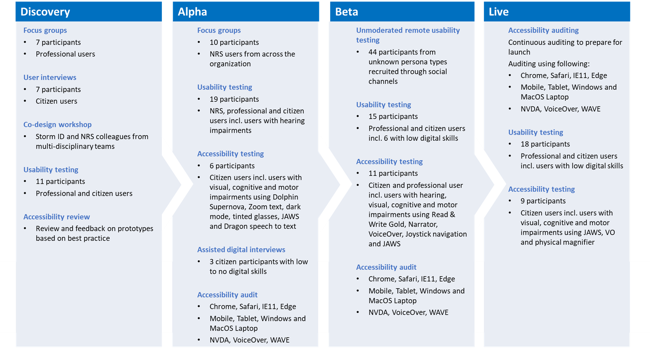
Website – Research Overview

Slide 61





Website – Research Outcomes
Hard to navigate via menu or site search
Improved site structure, increased task completion
Restrictive data search journey
Multiple ways of searching for a table – flexible user journeys
Emphasis on user knowledge to understand search and data
Data in different formats and varying levels of detail
Inaccessible data
Accessible data in a variety of formats
Specialist language confusing new users
Clear content describing what census data is used for and why

Slide 62
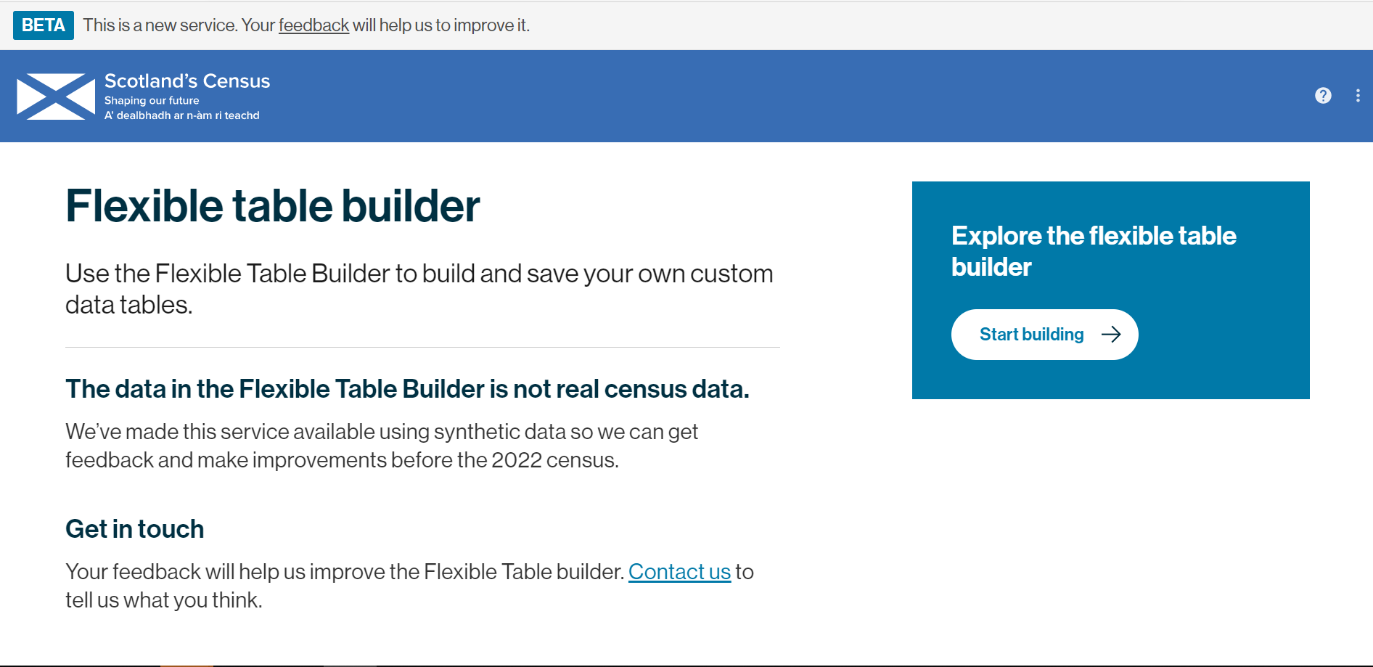
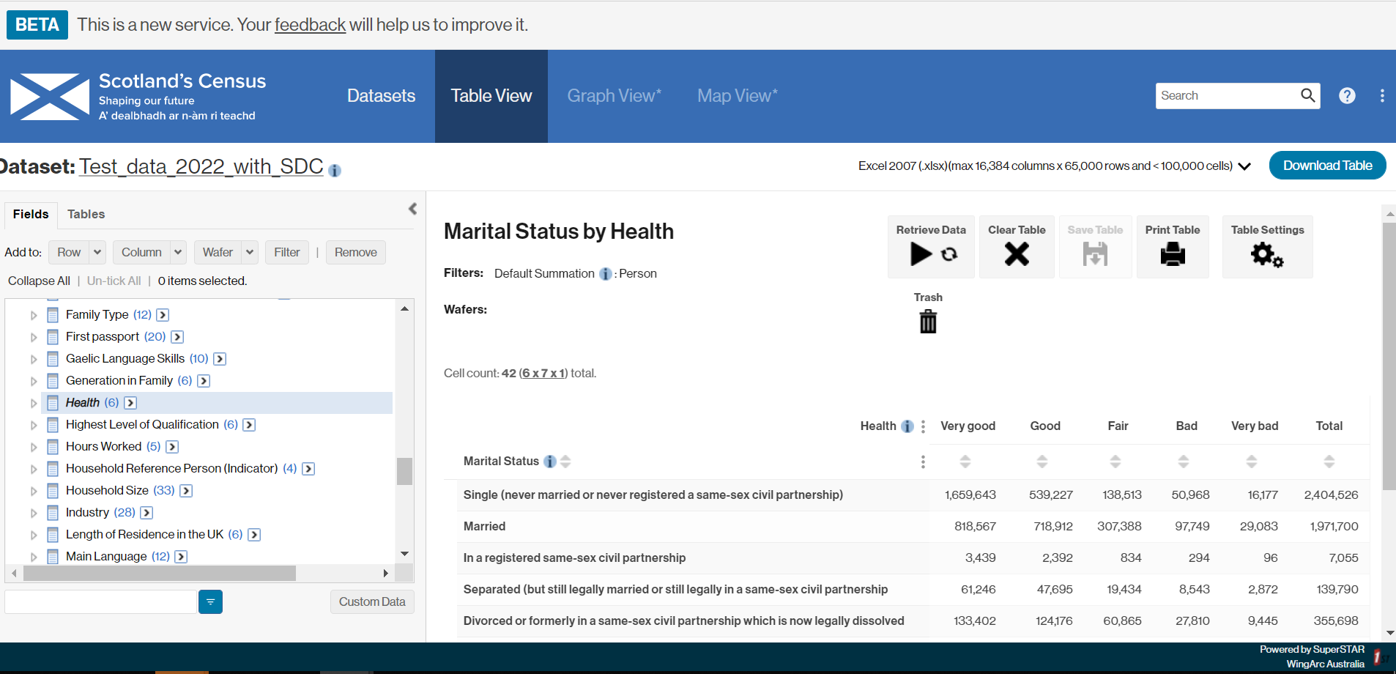
Flexible Table Builder - Beta
The Flexible Table Builder will be the primary dissemination tool for Scotland’s Census 2022 data
Users to create their own tables, reducing the need for the wide range of standard tables.
We will still publish standard tables where we identify user need.
The Flexible Table Builder beta is now publically available and will be an opportunity for users to give us feedback ahead of publishing census data.

Slide 63
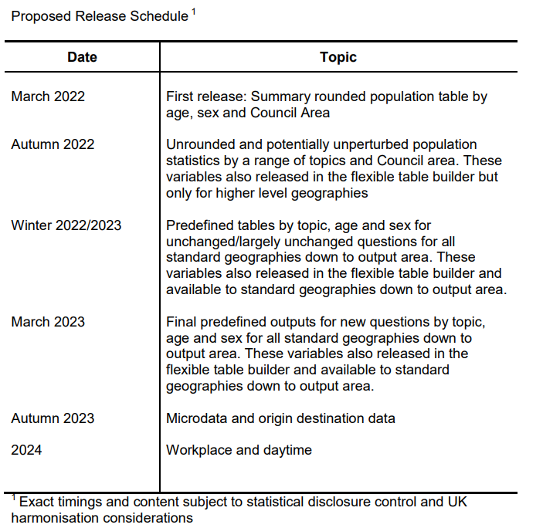
Outputs Release Plans
Last year we published a provisional high level release schedule for census outputs
We are looking for users to give us feedback on whether the proposed schedule still meets users needs
What data are users planning on using?
Variables
Timing
Other requirements
How are users planning on accessing Census data?
Flexible Table Builder
Standard Tables (Same as 2011)
Other (Microdata, API etc.)

Slide 64
Output Variables Update
NRS will create updated versions of our 2011 census output variables for use with Scotland’s Census 2022 data
Whenever possible these variables will maintain comparability with historical data, in particular with the 2011 census
We are currently working to develop new output variables for new census questions
NRS will continue to engage with users to understand the data requirements around these new questions and create output variables accordingly

Slide 65
UK Harmonisation
We are continuing to work closely with colleagues from ONS and NISRA
Creating variables which are comparable across the UK wherever possible.
This work is continuing following the move of Scotland’s Census to 2022
The UK offices are working together closely to investigate means for mitigating issues around comparability with respect to the differing Census reference periods
We are engaging with users of UK data to understand requirements around UK level analysis

Slide 66
UK Harmonisation
The Office for National Statistics (ONS) have set up a UK Data User Working Group, aimed at those who would like to engage with us about developing and using UK data outputs.
If you would like to register an interest in joining this group, please email
census.outputs@ons.gov.uk

Slide 67
Other NRS Statistics

Slide 68
NRS Demographic Statistics
In addition to the census, we publish a range of demographic statistics
Population estimates for councils, neighbourhoods and other areas
Population projections
Migration statistics
Household estimates and projections
Births, adoptions, marriages, civil partnerships
Deaths from different causes (including Covid)
Life expectancy and healthy life expectancy
Electoral statistics
Baby names
Summary reports
‘Scotland’s Population’ overview
Council area profiles

Slide 69
Changes to our statistics
New analysis published in recent years
Analysis of deaths involving Covid-19
Homeless deaths
Healthy life expectancy
Developments
Reviewing/developing sources of data on migration
Population and household estimates published on 25 June 2021
National population projections published in December 2021

Slide 70
Demographic statistics and the census
Our demographic data will be compared to the census figures.
We revise our population and household statistics after the census, and revise the figures since the last census.

Slide 71
Thank You!

